Slide 1

Predictive Machine Learning model for Car Insurance Claim Probability
By
Manish Dongre

Slide 2


OBJECTIVE
Objective of Project:
To develop a predictive model that assesses the claim probability for car insurance policies. The objective would be to understand the factors that influence claim frequency and severity in the period of six months and enable insurance companies to better assess risk and determine appropriate premiums for policyholders.

Slide 3









PROJECT OUTLINE
Business Understanding
Understand the business problem or objective. Deriving the goals and approach to the solution.
Data Collection
Collect data from various sources, Clean, preprocess, and validate the data.
EDA
Understand its structure, distributions, and relationships. Use plots, histograms, and summary statistics.
Feature Engineering
Transform raw data into informative features. Encode them (e.g., one-hot encoding). Normalize or standardize them.
Model Building
Choose appropriate machine learning models (e.g., regression, decision trees, neural networks). Use metrics (e.g., accuracy, precision, recall) to assess model effectiveness.
Result & Interpretation
Apply the trained model to new data. Present results to stakeholders, making them actionable.

Slide 4

BUSINESS UNDERSTANDING
Understanding the car insurance policy business
Key Concepts:
Car Insurance Policies provide financial Protection against damage or loss to the vehicle and liability for any resulting injuries or property damage.
Policies typically cover events such as accidents, theft, vandalism, and Natural Disasters.
Processes Involved:
The Car Insurance Policy business Involves various processes, Including policy underwriting, premium calculation, claim management, and risk assessment.
Insurance Companies assess risk factors such as the drivers age, driving history, Vehicle type, and location to determine policy terms and premium

Slide 5
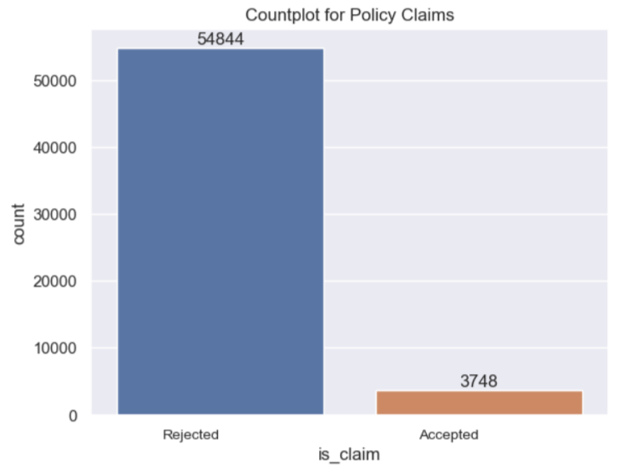
INTRODUCTION
Predictive Machine Learning Model for Car Insurance Claim Probability
This presentation will discuss a predictive machine learning model that accesses the claim probability of car insurance policies.
The model utilizes advanced algorithms to analyse various factors and predicts the likelihood of claim
By accurately assessing claim probability, Insurance companies can make informed decisions and optimize their operations.
The dataset of an Insurance company has 58592 cases, where most of the cases were classified as 0 (i.e. Rejecting the insurance claim request) while small percentage of dataset is classified as 1 (i.e. accepting the insurance claim request).
We have to develop a Machine Learning (ML) model to predict whether or not the unknown request for claim will be accepted or rejected.
No of columns – 44 Nos
No of Rows – 58593 Nos

Slide 6
UNDERSTANDING THE DATA
The data contains 44 columns giving different aspects of car insurance policy procedure. It can be divided into 4 categories.
Summary of the attributes used for building Machine Learning Model
Insurance Data | Vehicle Specification | Vehicle Accessories | Decision
policy_id, policy_tenure, age_of_car, age_of_policyholder etc. | Make, model, fuel_type, max_torque, cylinder engine_type, gross_weight etc. | is_adjustable_steering, is_tpms, is_parking_sensors, is_front_fog_lights, is_central_locking, is_power_steering etc. | Is_claim (Target column) 0- Not Accepted, 1- Accepted
Independent Attributes |  |  | Dependent Attribute

Slide 7
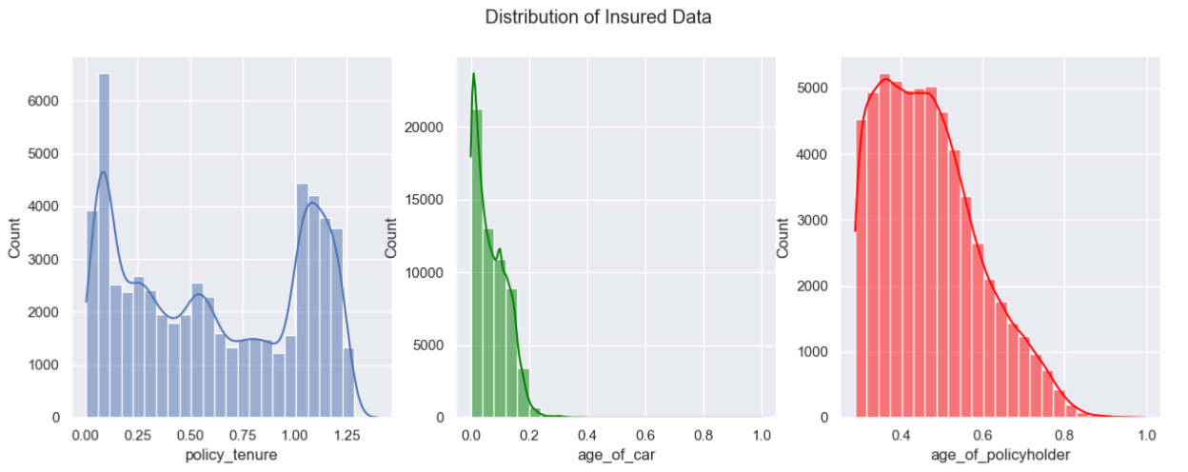
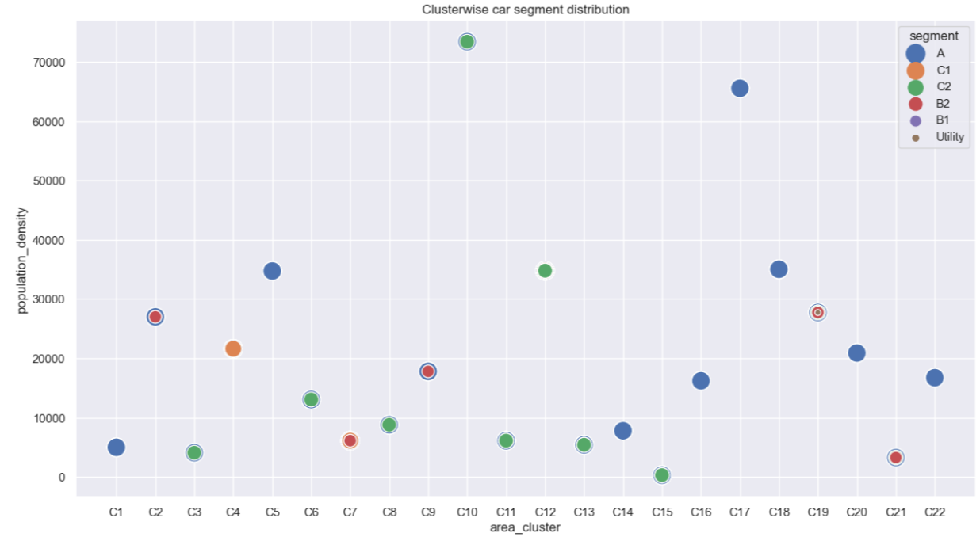
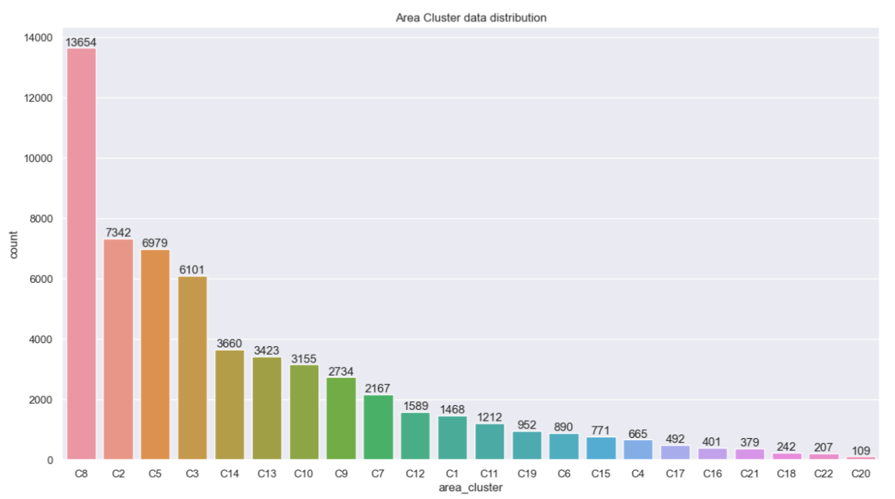
EXPLORATORY DATA ANALYSIS (EDA)
Most policy holders are of young age group with some are in the middle age group
The policy tenure is distributed for different time period
Most of the cars in the dataset are newly purchased.
The lowest population density is in C15 area and highest population density is in C10 area.
Maximum cars are from C8 area and least cars ore from C20 area

Slide 8
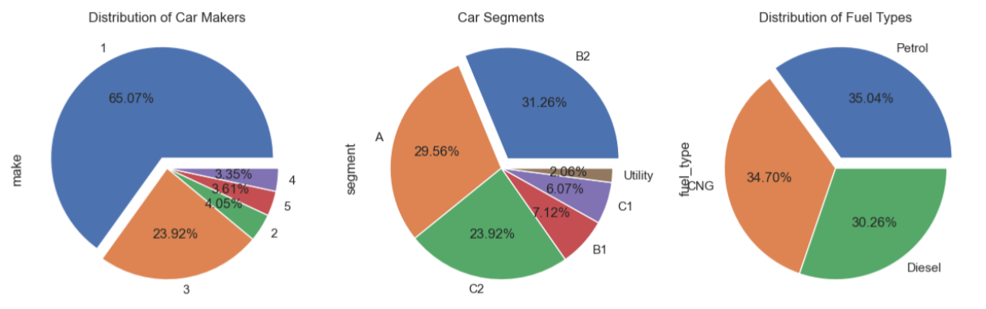
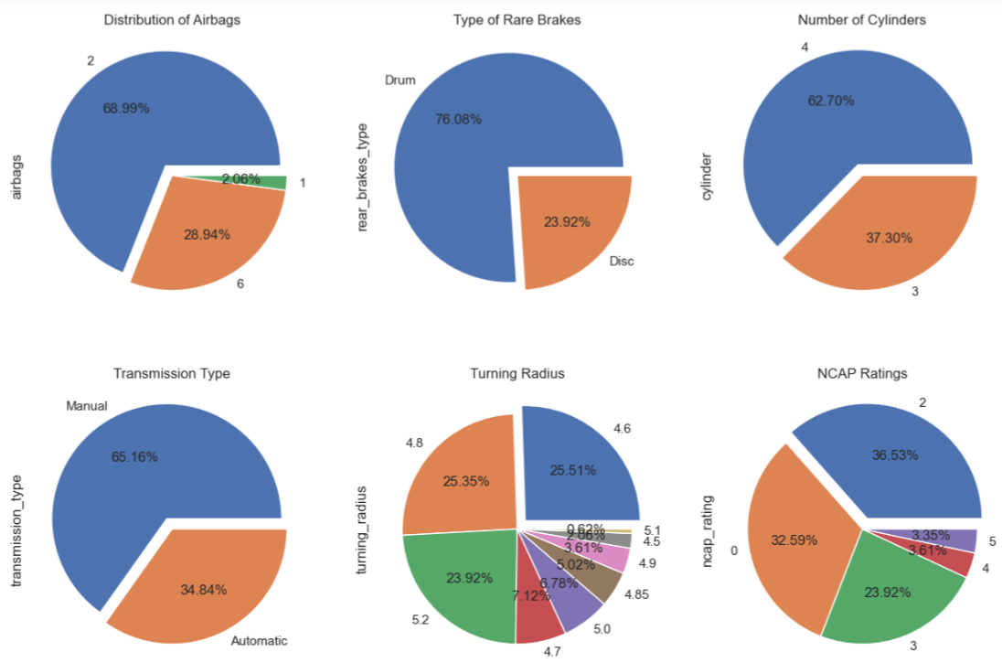
Univariate Analysis
65% of cars are manufactured by 1st Car maker.
85% of Cars belonging to [A, B2, C2] segment.
The Fuel Types of the cars are equally distributed.
69% of cars have 2 airbags. 29% have 6 airbags.
Most cars have Drum type rare brake system.
63% cars have 4 cylinder engine.
66% of cars have Manual type transmission gearbox
Most cars have Turning radius in the range of 4.6 to 5.2
The NCAP rating is very important attribute for car Insurance. As it determine safety of the car.
37% of cars have ratings of 2 on the scale of 0 to 5

Slide 9
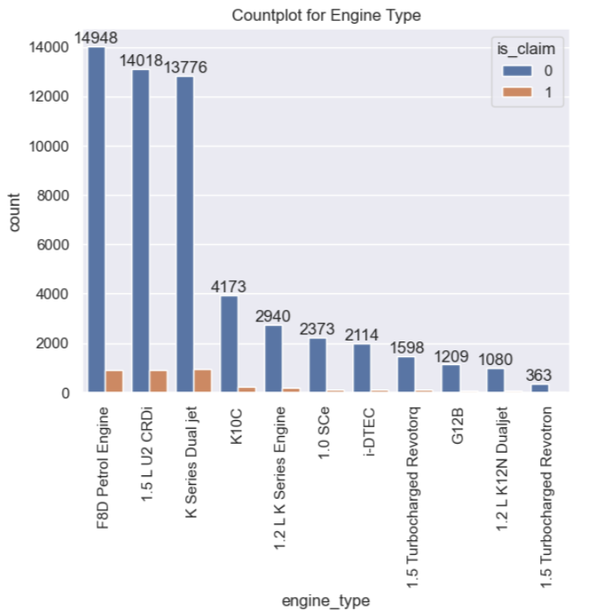
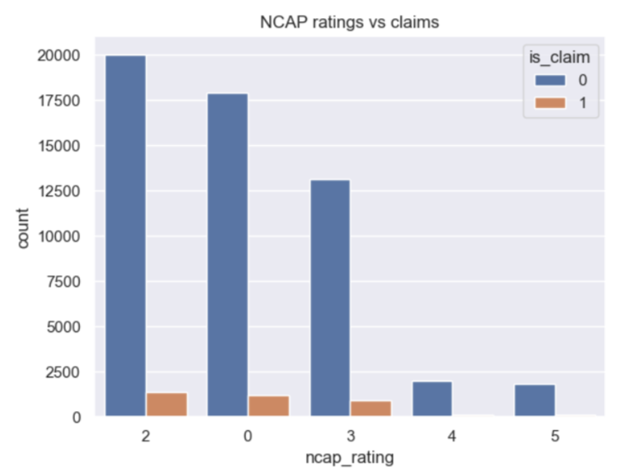
Multivariate data Analysis
Most of the cars are belonging to top 3 Engine categories.
K Series Dual jet engine type have slightly more claim acceptance rate than the other engine types.
Higher the NCAP ratings the claim acceptance rate is proportionately higher.
Rating 3 have proportionately higher claim percentage.

Slide 10
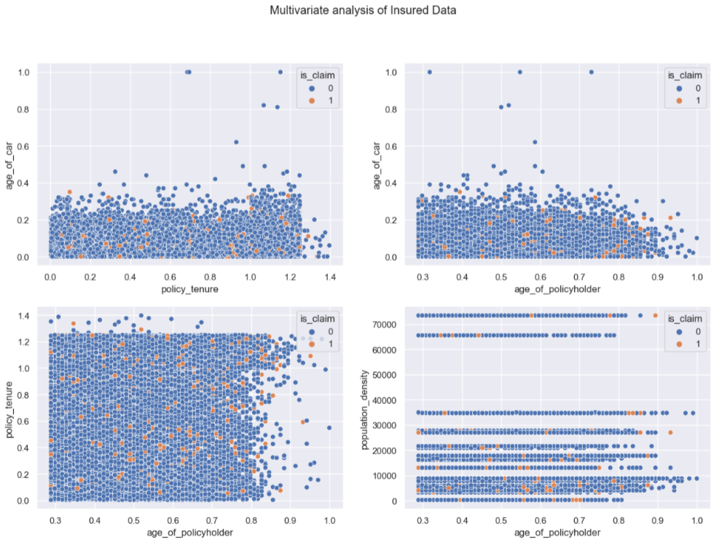
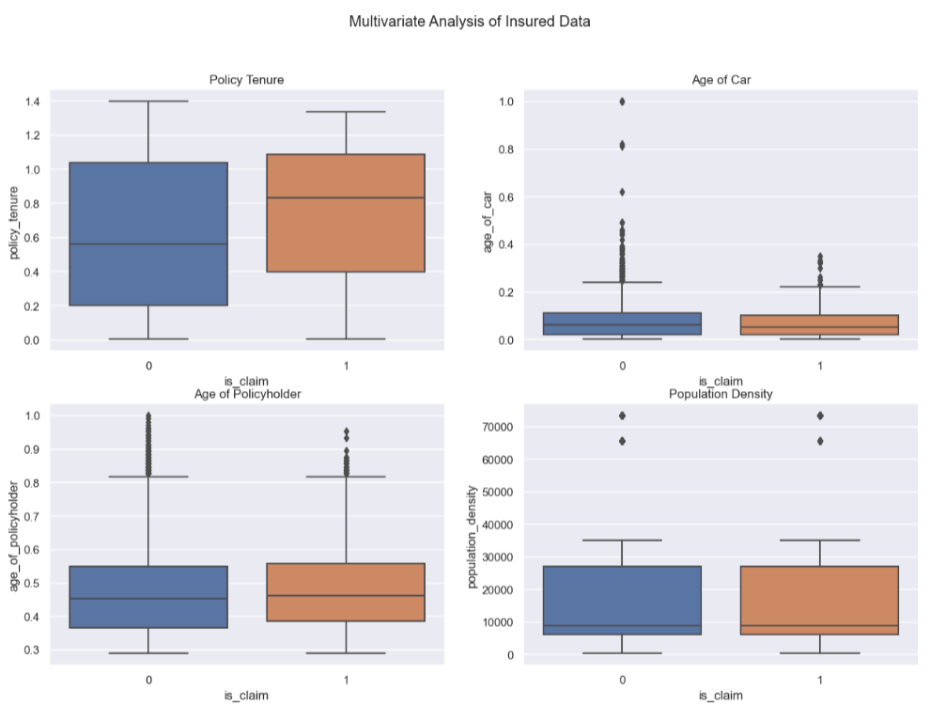
Multivariate Analysis with Target Variable
The newly purchased cars having higher policy tenure are more likely to settle a policy claim.
The new cars and higher age of policyholder is more likely to settle a policy claim.
More the population density, it is less likely to settle a policy claim.
It can be observe that in case of policy tenure the median value of claimed policies is higher than non claimed policies. Indicates that high tenure policies are more likely to settle claims than lower tenure.
Age of Car, Age of policyholder, and population density have minimal effect in settling a claim

Slide 11
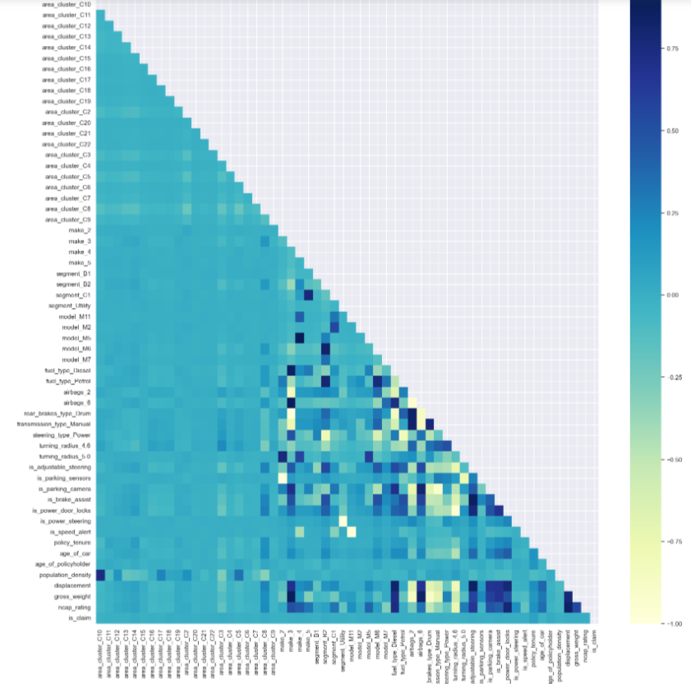
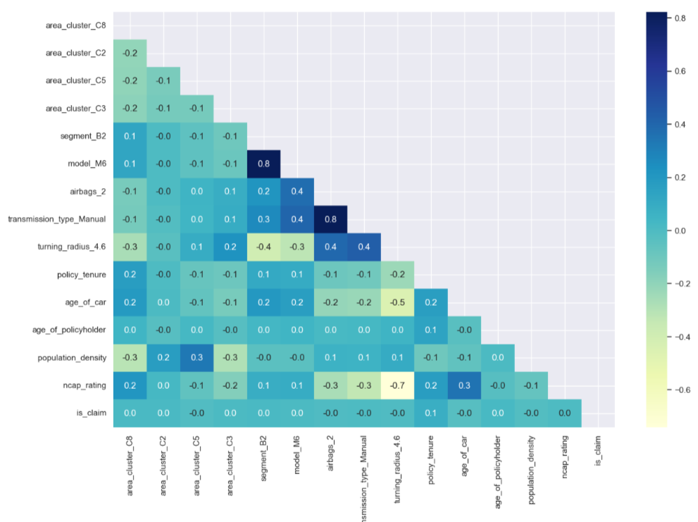
FEATURE ENGINEERING
Peak Torque: The point where torque is highest at specific rpm
Peak Power: The point where power is highest at specific rpm.
Horsepower (hp) = Torque × rpm / 5,252
Dissolution of Multicollinearity problem
Technique 1: Highly Correlated Columns elimination
When multicollinearity occurs, it can impact the interpretability of the model. making it challenging to isolate their individual effects on the target class.
Technique 2: Variance Inflation Factor (VIF)
The variance inflation factor can estimate how much the variance of a regression coefficient is inflated due to multicollinearity.

Slide 12
MODEL BUILDING
Imbalanced Data Handling:
Insurance data is imbalanced (more non-claim cases than claim cases). Use resampling techniques:
Random Oversampling
SMOTE (Synthetic Minority Over-sampling Technique)
Random Under sampling
Hybrid methods (combining oversampling and under sampling)
Model Selection:
The 8 algorithms we are going to use are:
Logistic Regression
Random Forest
Multilayer Perceptron (MLP)
Support Vector Machine (SVM)
Naive Bayes (NB)
Decision Tree (DT)
XG Boost
AdaBoost
Measurement of Outcome using Efficiency Metrics
To measure the performance of the model we are going to use seven classifier efficiency measures.
Accuracy: Accuracy measures how often the classifier correctly predicts the target class.
Accuracy= (TP+TN)/ (TP+FP+TN+FN)
Sensitivity/ Recall: Sensitivity (also known as recall) measures the proportion of actual positive cases correctly predicted by the model.
Sensitivity=TP/(TP+FN)
Specificity: Specificity measures the proportion of actual negative cases correctly predicted by the model.
Specificity=TN/(FP+TN)
AUC (Area Under the Receiver Operating Characteristic Curve): AUC-ROC quantifies the model’s ability to distinguish between positive and negative classes across different probability thresholds.
Precision: Precision measures the proportion of true positive predictions among all positive predictions made by the model.
Precision =TP/(TP+FP)
F1-measure: F1-score balances precision and recall. It considers both false positives and false negatives.
F-measure= (2* Precision* Recall) / (Precision + Recall)
Kappa: Kappa assesses the agreement between predicted and actual values, considering the possibility of random agreement.
K=(Pr(a)-Pr(e))/(1-Pr(e))
Where:
Pr(a) represents the observed agreement between the raters, which is the proportion of cases where the raters agree.
Pr(e) represents the expected agreement between the raters by chance.

Slide 13
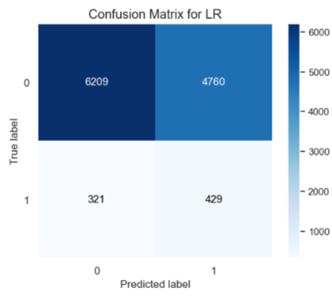
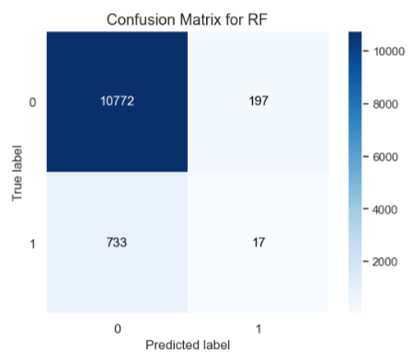
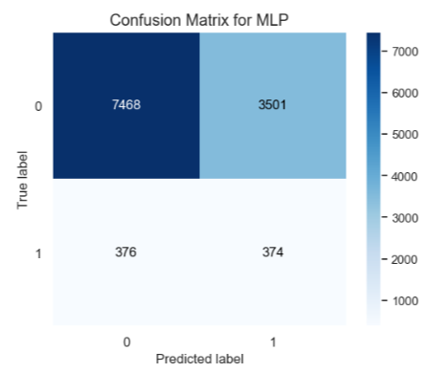
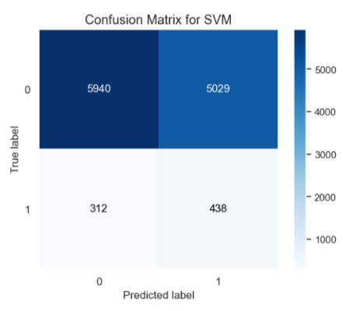

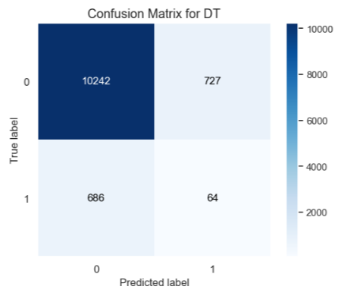
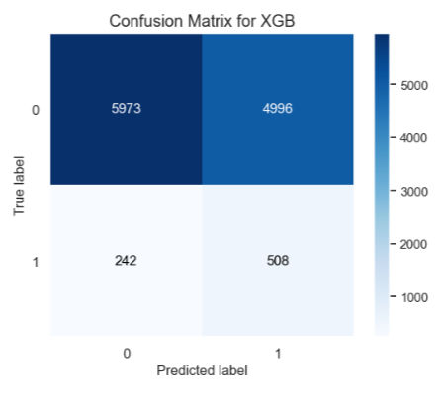
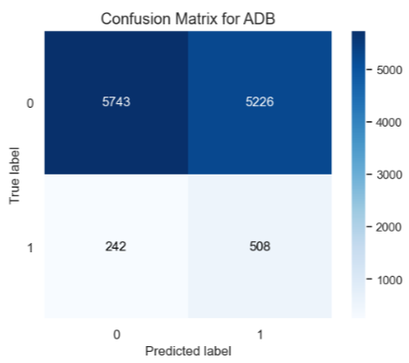
OUTCOME OF THE MODEL USING RANDOM OVERSAMPLING
Logistic Regression
Random Forest
Multilayer Perceptron
Support Vector Machining
TN
FP
TN
FP
TN
FP
TN
FP
FN
TP
FN
TP
FN
TP
FN
TP
Decision Tree
XG Boost
AdaBoost
Naïve Bayes
TN
FP
TN
FP
TN
FP
TN
FP
FN
TP
FN
TP
FN
TP
FN
TP

Slide 14
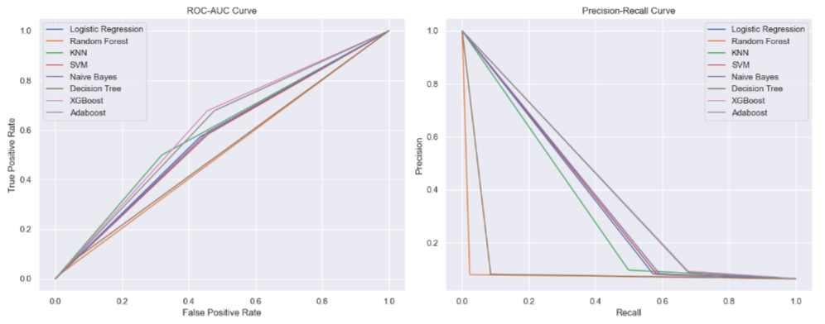
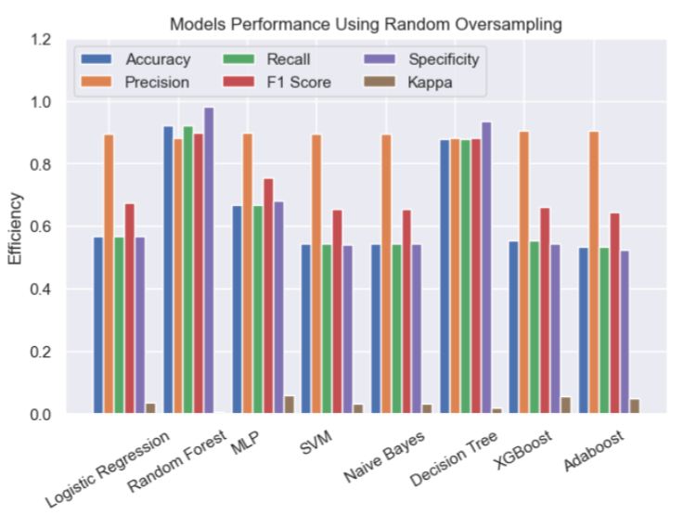
MODEL PERFORMANCE MEASUREMENT
Technique 1: Random Over Sampling
ROC AUC curve provides insights into how well a model discriminates between classes, and a larger AUC signifies better predictive ability.
AUC measures the probability that the model assigns a randomly chosen positive instance a higher predicted probability than a randomly chosen negative instance.
Here, the Random Forest model is showing better ROC value than other model
Technique 1: Random Over Sampling
Efficiency Metrics for Random Forest:
Accuracy: 0.9206
Precision: 0.8814
Recall: 0.9206
F1 Score:0.8995
Specificity: 0.9820
Kappa: 0.0070
TP : 17
TN : 10772
FP : 197
FN : 733

Slide 15
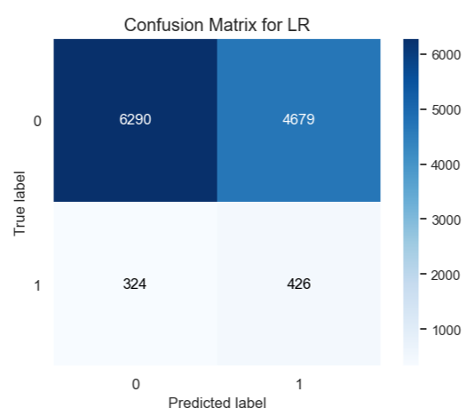
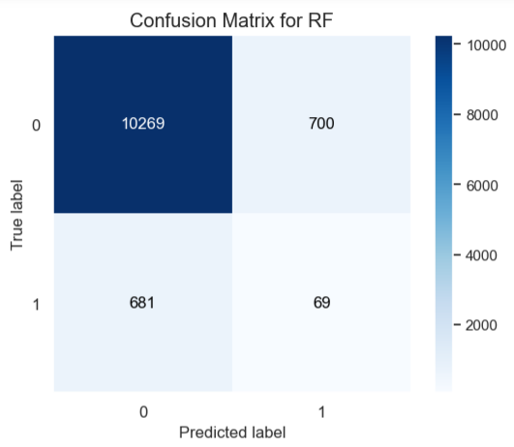
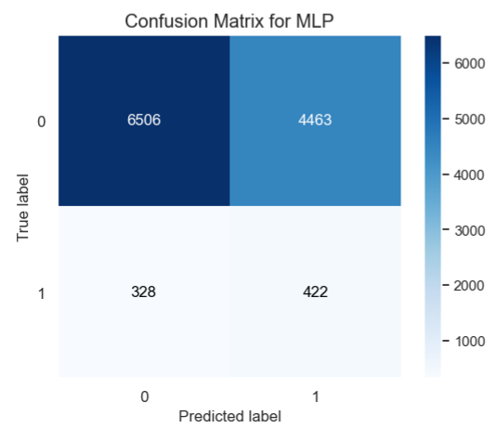

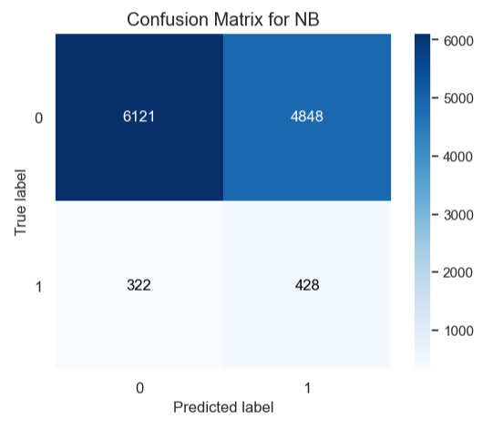


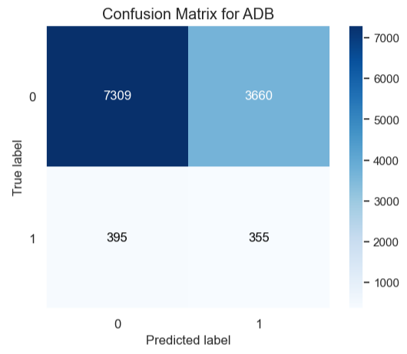
OUTCOME OF THE MODEL USING SMOTE TECHNIQUE
Logistic Regression
Random Forest
Multilayer Perceptron
Support Vector Machining
TN
FP
TN
FP
TN
FP
TN
FP
FN
TP
FN
TP
FN
TP
FN
TP
Naïve Bayes
Decision Tree
XG Boost
AdaBoost
TN
FP
TN
FP
TN
FP
TN
FP
FN
TP
FN
TP
FN
TP
FN
TP

Slide 16
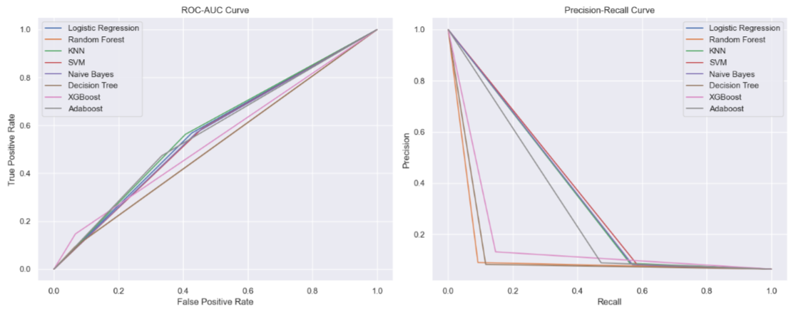
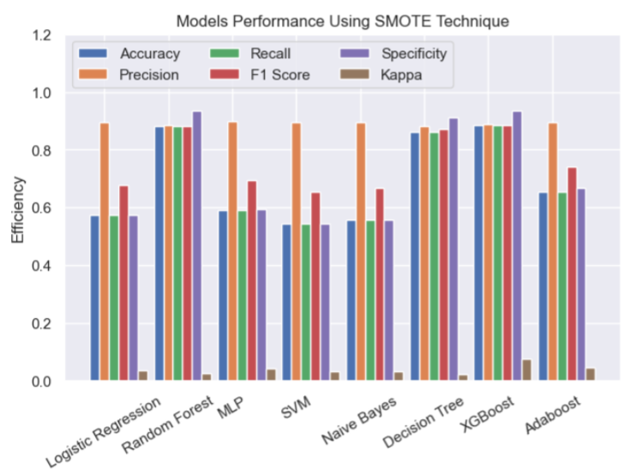
MODEL PERFORMANCE MEASUREMENT
Technique 2: SMOTE
Precision measures the proportion of true positive predictions out of all positive predictions.
Recall quantifies the proportion of actual positive instances correctly predicted by the model.
A high area under the PR curve indicates a model that balances both high precision and high recall.
Here, The Random Forest Model is giving us the higher Precision-Recall area.
Technique 2: SMOTE
Efficiency Metrics for Random Forest:
Accuracy: 0.8821
Precision: 0.8835
Recall: 0.8821
F1 Score:0.8828
Specificity: 0.9361
Kappa: 0.0270
TP: 69
TN: 10269
FP: 700
FN: 681

Slide 17
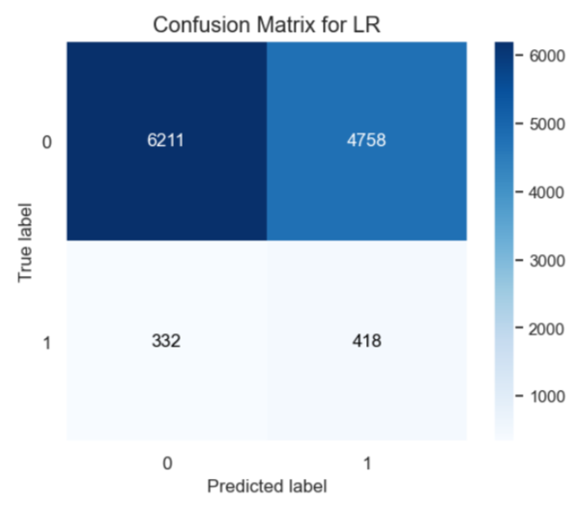
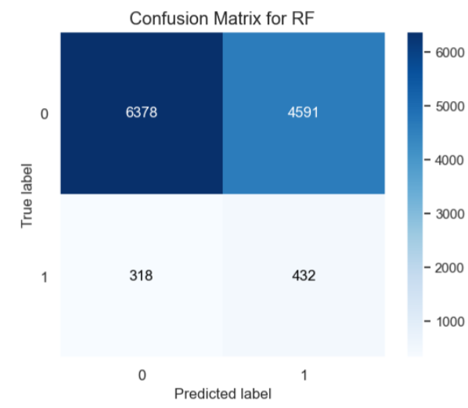
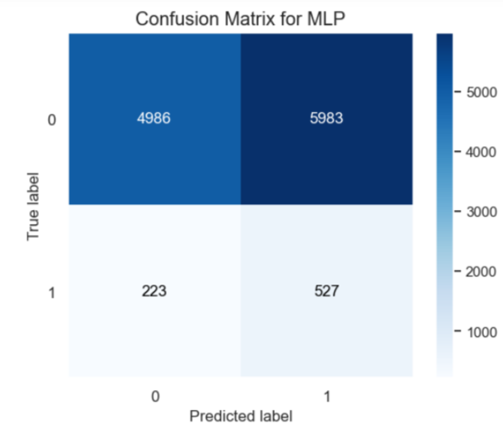
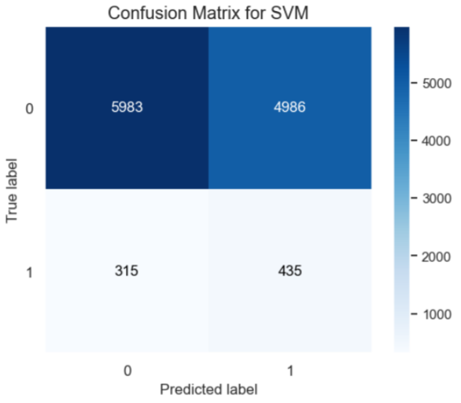
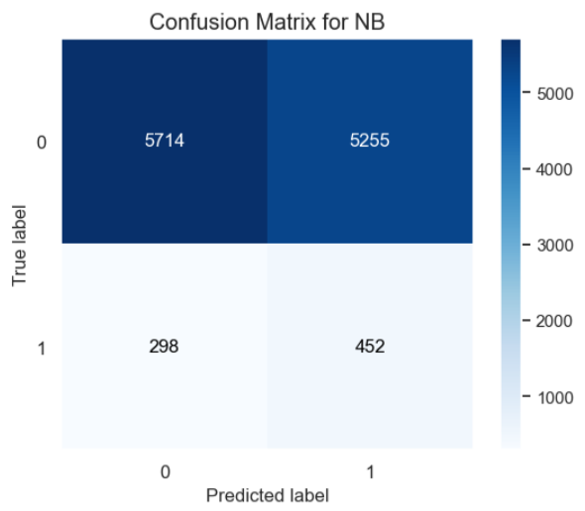
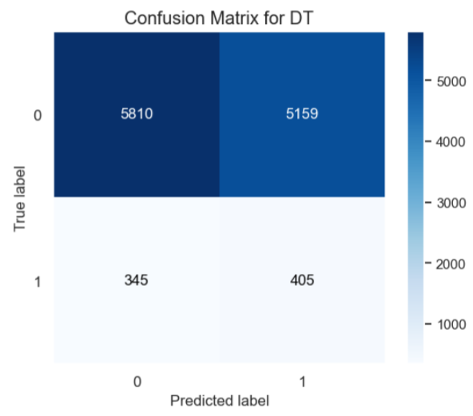

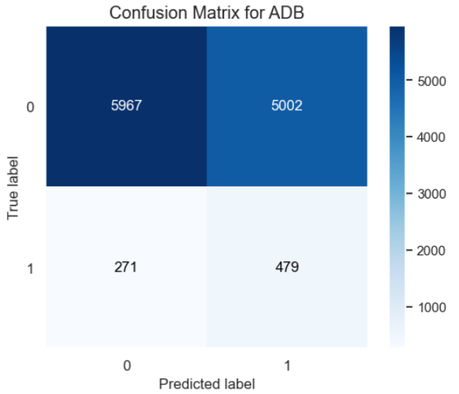
OUTCOME OF THE MODEL USING RANDOM UNDER SAMPLING
Logistic Regression
Random Forest
Multilayer Perceptron
Support Vector Machining
TN
FP
TN
FP
TN
FP
TN
FP
FN
TP
FN
TP
FN
TP
FN
TP
Naïve Bayes
Decision Tree
XG Boost
AdaBoost
TN
FP
TN
FP
TN
FP
TN
FP
FN
TP
FN
TP
FN
TP
FN
TP

Slide 18
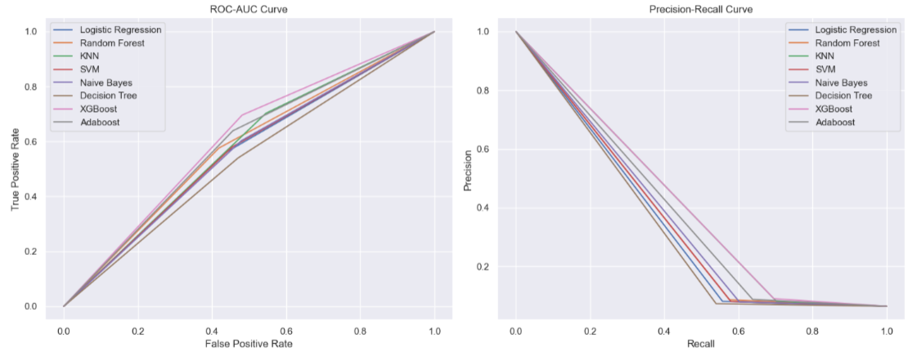
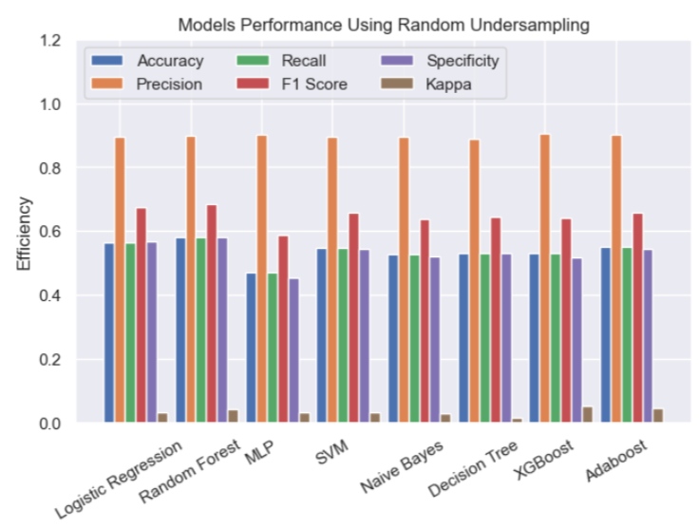
MODEL PERFORMANCE MEASUREMENT
Technique 3: Random Under Sampling
Cohen’s kappa is a valuable metric used to assess the agreement between two evaluators. It also finds application in evaluating the performance of a classification model.
A value of 0 indicates no agreement .
A value of 1 signifies perfect agreement.
Generally, a kappa value above 0.7 is considered to be very good agreement.
Technique 3: Random Under Sampling
Efficiency Metrics for Random Forest:
Accuracy: 0.5811
Precision: 0.8835
Recall: 0.5811
F1 Score:0.6854
Specificity: 0.5814
Kappa: 0.0430
TP: 4591
TN: 6378
FP: 432
FN: 318

Slide 19
RESULT AND INTERPRETATION
After comparing all the model using different resampling techniques and different model algorithms we can finalize the following outcomes:
The random forest (RF) classifier with Random oversampling has the best performance, with an accuracy of 0.92, a precision of 0.88, recall of 0.92, an F-measure of 0.8995, specificity of 0.9820 and a kappa of 0.007. This means that the RF classifier is accurate in predicting whether accept or reject the policy claim and minimize the cost of an Insurance Company.
The Random Oversampling technique outperformed all other resampling techniques, achieving an accuracy of 92% for the random forest (RF) classifier.
The random forest model is consistent for different resampling techniques.
Decision Tree model and XG Boost Model are also giving close result using SMOTE resampling technique.
As the objective is to understand the factors that influence claim frequency and enable insurance companies to better assess risk and determine appropriate premiums for policyholders. The random forest model predicts the non acceptance of policy claim with specificity of 98%. Which indicates business can demand minimum premium from the customers and improve their customer base thereby increasing their profit.

Slide 20
CONCLUSION
Summary of Findings:
Our predictive machine learning model successfully assessed the claim probability of car Insurance policies with high accuracy
The model Identified key factors that significantly Impact claim probability, such as Policy tenure, Age of car and NCAP rating.
By leveraging advanced algorithms and large datasets we were able to develop a robust model that outperforms traditional methods and claim assessment.
Implications:
The use of our predictive model can help car insurance companies Improve their underwriting process and pricing strategies.
By accurately assessing claim probability, Insurers can better manage risk and offer more competitive premiums to policyholders.
The model can also be used for fraud detection, Identifying suspicious claims and reducing fraudulent activities in the insurance Industry

Slide 21

Thank You!

